Slide 1
Car Sales
Car Management System

Slide 2
Agenda
01
02
03
04
05
06
Database Scope
Functional Requirements
Non-Functional Requirements
Business Rules
Database Design
Code

Slide 3
01
Database Scope

Slide 4
Database Scope
1. The type of data that is stored: The car sales database will store information about cars, customers and sales.
2. The size of the database: The size of the database will depend on the number of cars, customers and employees that the dealership has.
3. The frequency of data updates: The database will be updated frequently, as new cars are added to the inventory, new customers are acquired, and new sales are made.
4. The level of security required: The database will require a high level of security, as it will store sensitive information such as customer contact information and financial data.

Slide 5
02
Functional Requirement

Slide 6
Functional Requirement
1-Each member can log in or out of the system, through the username and password, after verifying the validity of data, and in the event that any of them (name, password) is entered wrong, access to the system will be refused
2-The customer can reserve the car
3-The customer can book an appointment to repair the car
4-The customer can book an appointment to test drive the car before buying it
5-The customer can pay for a car online, after inserting credit card info.
6-The customer can pay invoice online, after inserting credit card info.

Slide 7
Functional Requirement
7-The employee can license the cars before selling them
8-The employee can create an account for the customer, after checking their data
9-The employee can register a new mechanic to system
10-The employee can search the available cars in internal and external inventories
11-The manager must approve selling process 12-The manager can see the employee's working hours
13-The manager can see the employee's sales numbers
14-The manager can review the reports of the different operations performed

Slide 8
03
Non-Functional Requirement

Slide 9
Non-Functional Requirement 1. Use a web browser to access the system. 2. utilizing a web browser to access the system 3. The precision with which the website responds to a user's inquiry 4. putting usability first when getting orders from the user 5.site is free of problems when looking for a particular item

Slide 10
04
Business Rules

Slide 11
Business Rule
The sales center is organized into agencies.
Each agency has a unique location, a unique number, multiple phone numbers and a particular employee who manages the agency.
An agency stores a number of cars, each car has a name, a unique model, an engine name, a price, a quantity and a unique vehicle identification number (VIN)
The database will store each employee’s name (First name, Middle name, Last name), Social Security number (SSN), address, salary, gender, and birth date.
An employee is assigned to one agency but sells several cars.
The database will store each customer’s name (First name, Middle name, Last name), Social Security number (SSN), E-mail, phone, and the customer can buy multiple cars

Slide 12
05
Database Design

Slide 13
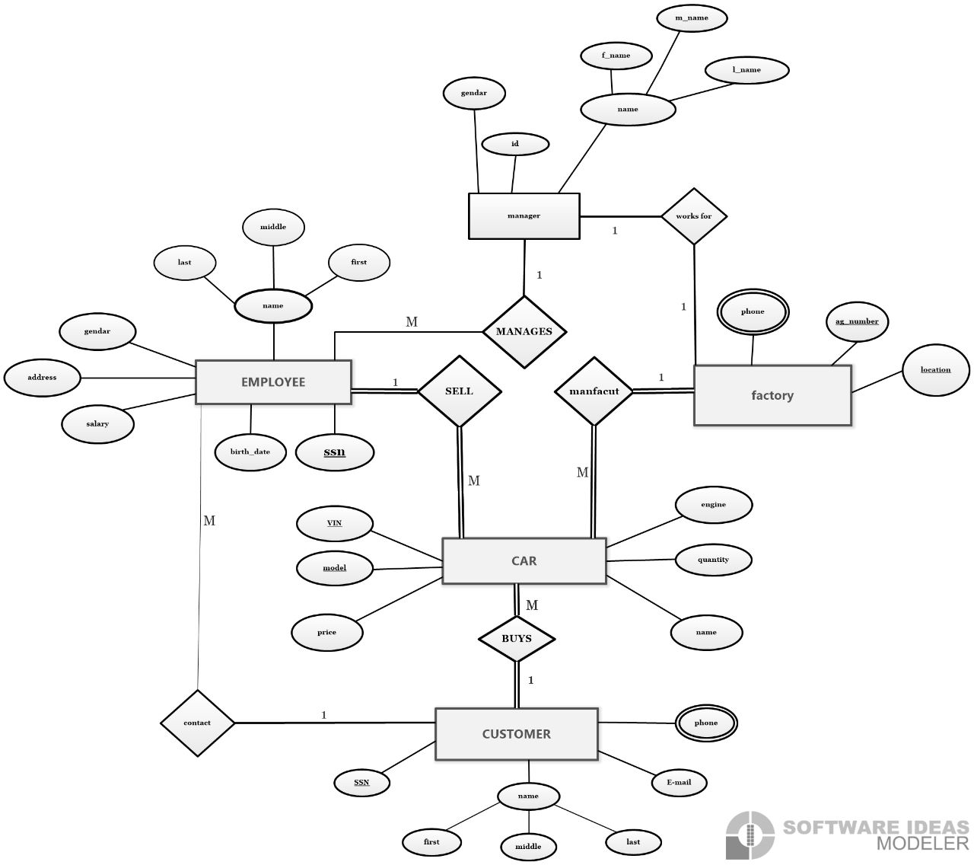

Slide 14
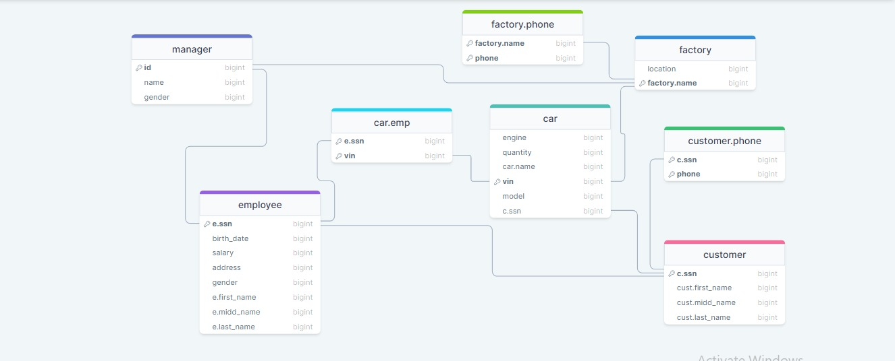

Slide 15
06
Code

Slide 16
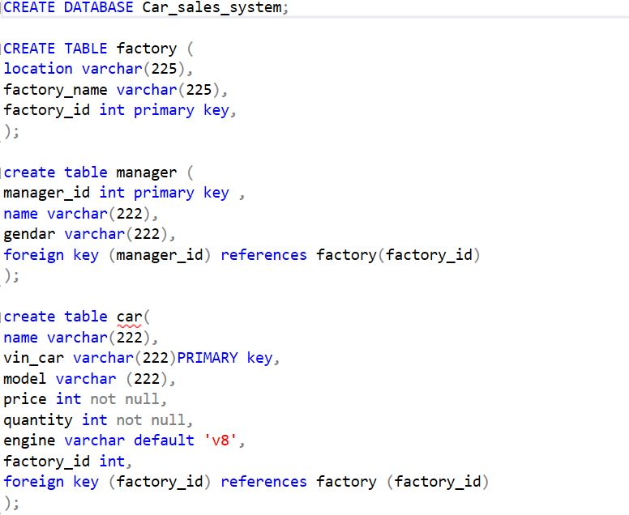

Slide 17
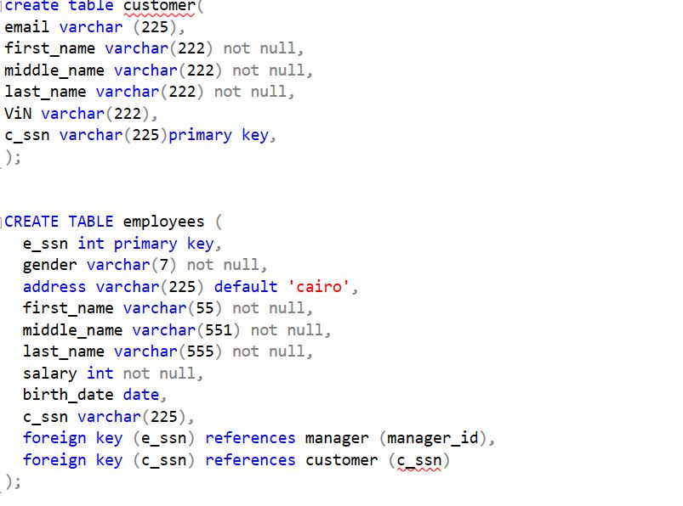

Slide 18
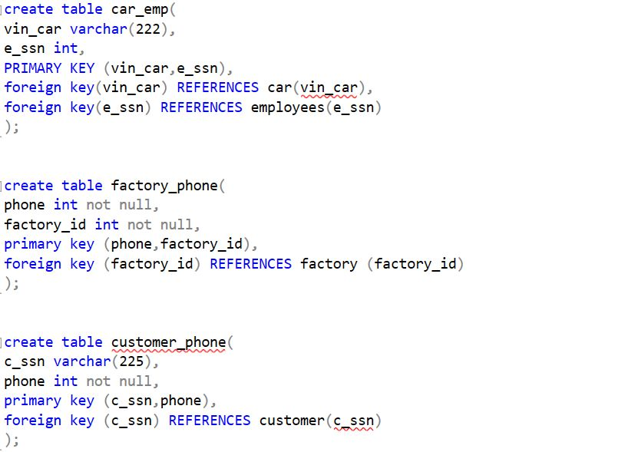

Slide 19
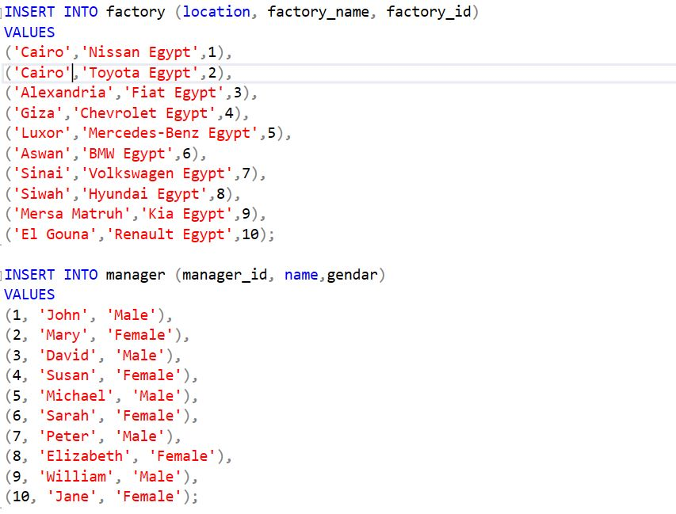

Slide 20
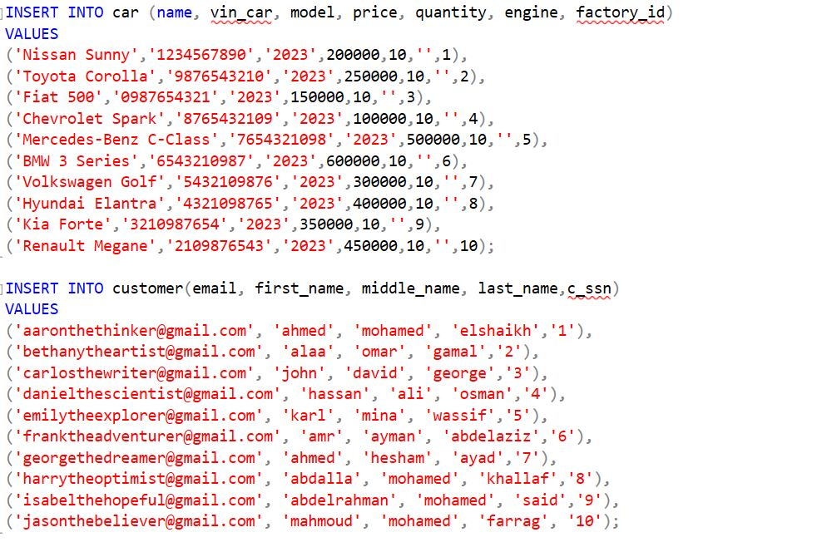

Slide 21
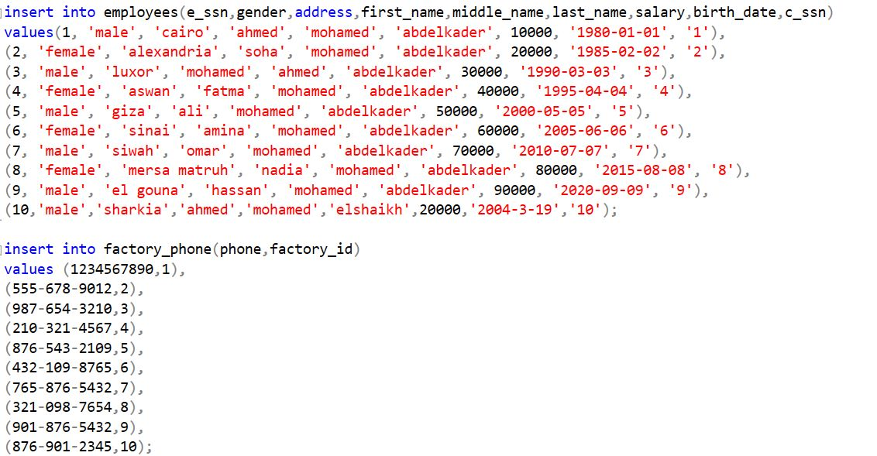

Slide 22
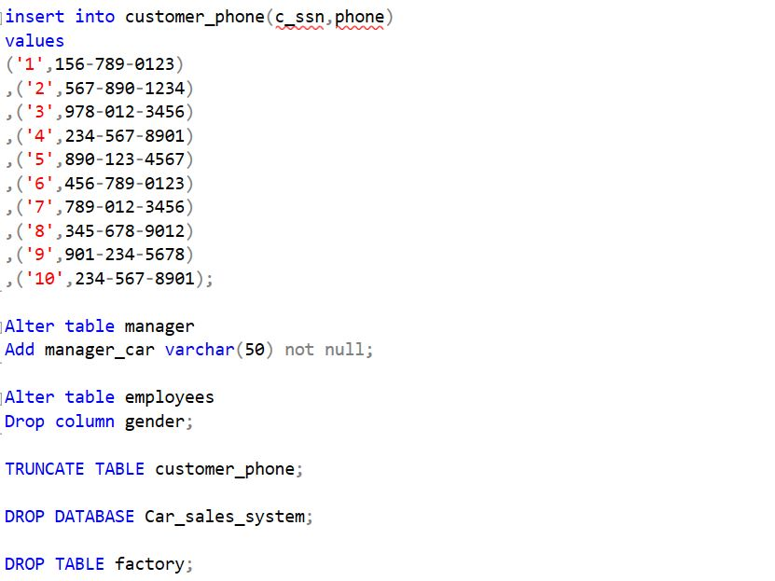

Slide 23
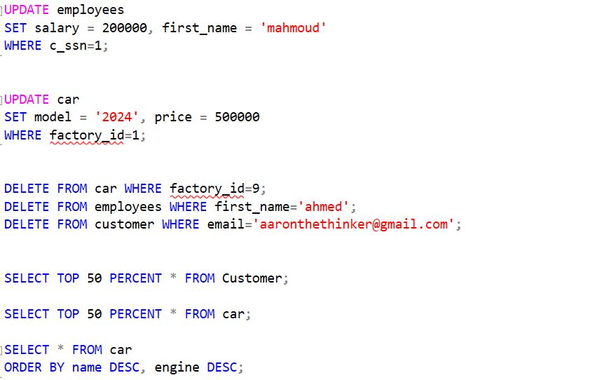

Slide 24
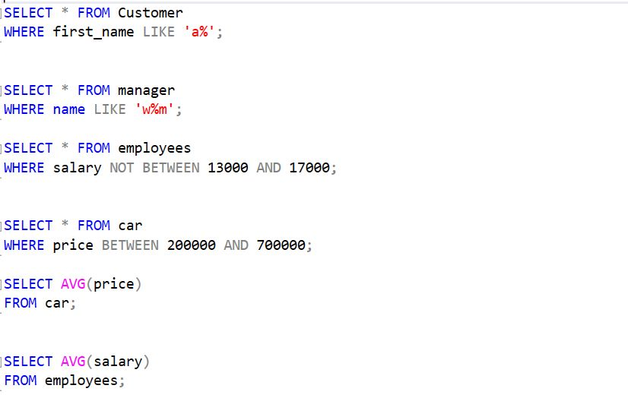

Slide 25
Thanks!
Do you have any questions?
youremail@freepik.com
+34 654 321 432
yourwebsite.com

